Slide 1
Anomaly detection in Machine Learning
Business project 1
Presented BY
V Govinthraj
Data Specialist

Slide 2
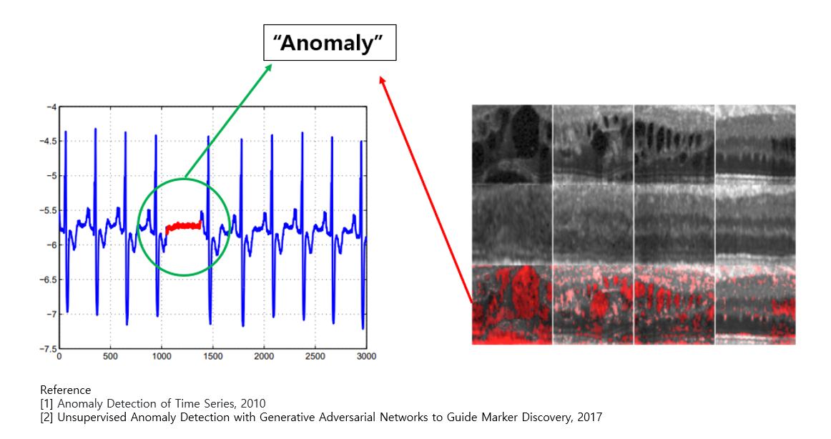
Anomaly detection

Slide 3
What?
Anomaly detection is a technique used to identify unusual patterns that do not conform to expected behavior, called outliers.
In general, Anomaly detection is also called Novelty Detection or Outlier Detection, Forgery Detection and Out-of-distribution Detection.
Anomalies are data points that are inconsistent with the distribution of the majority of data points.
Hawkins defined an anomaly as “an observation which deviates so much from the other observations as to arouse suspicions that it was generated by a different mechanism”
Anomaly detection has received considerable attention in the field of data mining due to the valuable insights that the detection of unusual events can provide in a variety of applications.
For example, in environmental monitoring of a wireless sensor network, outlier detection techniques can be applied to detect faulty sensors or interesting behavioral patterns.

Slide 4
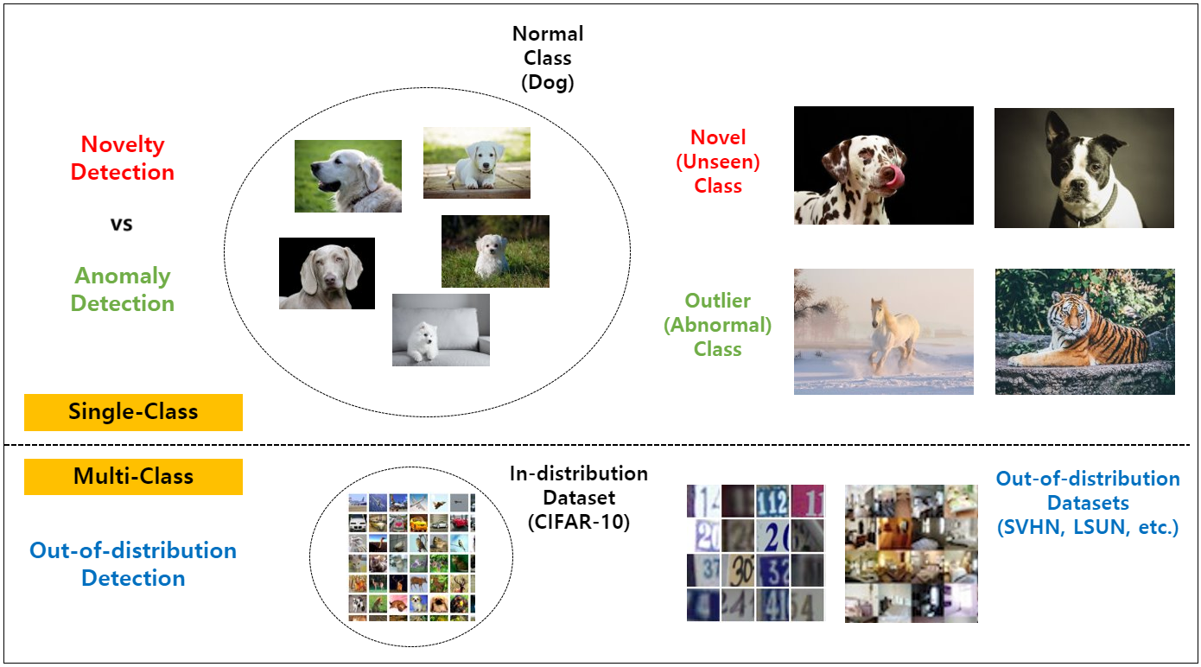
Just think…..

Slide 5
Types
Time-series anomaly detection
Video-level anomaly detection
Image-level anomaly detection
Anomaly Classification target
Out-Of-Distribution(OOD) Detection target
Anomaly Segmentation target

Slide 6
PyOD
PyOD is a comprehensive and scalable Python toolkit for detecting outlying objects in multivariate data.
This exciting yet challenging field is commonly referred as Outlier Detection or Anomaly Detection.
Since 2017, PyOD has been successfully used in various academic researches and commercial products.
It is also well acknowledged by the machine learning community with various dedicated posts/tutorials, including Analytics Vidhya, KDnuggets, Towards Data Science, Computer Vision News, and awesome-machine-learning.

Slide 7
PyOD is featured for:
Unified APIs, detailed documentation, and interactive examples across various algorithms.
Advanced models, including Neural Networks/Deep Learning and Outlier Ensembles.
Optimized performance with JIT and parallelization when possible, using numba and joblib.
Compatible with both Python 2 & 3.
References:
https://www.jmlr.org/papers/volume20/19-011/19-011.pdf

